Slide 1
Environmental sensors learning module design
Avtandil Tavkhelidze
Ilia State University

Slide 2
Grants & Development
1st grant holder in TEMPUS from Georgia. Partner in 27 Tempus projects, grant holder of 2 projects
15 Erasmus + CBHE projects, 2 as grant holder/coordinating university
2 funded partnerships under FP7
2 successful projects under Horizon 2020
1 Jean Monnet Network Project & 1 Jean Monnet Chair
More than 70 ongoing international grants
Income from international grants during 2006-2018: Over 30 million GEL

Slide 3
Industrial Cooperation and Creative Engineering Education based on Remote Engineering and Virtual Instrumentation (iCo-op) N530278-TEMPUS-1-2012-1-DE-TEMPUS-JPHES
Learning Modules
Renewable energy Module
National Instruments ELVIS Module
FPGA Module
Intellectual property Module

Slide 4
Learning Modules in Georgian language

Slide 5
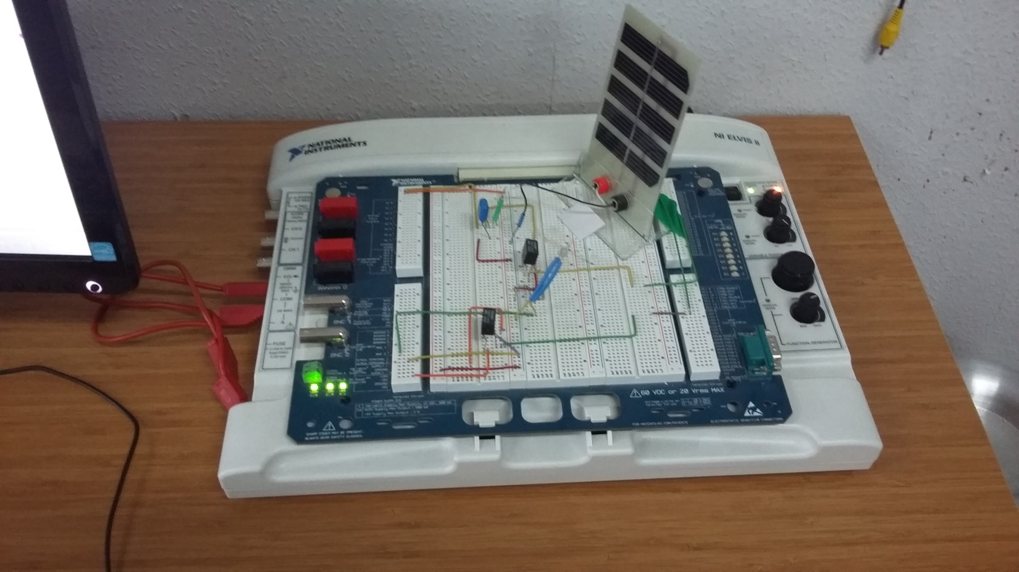
National Instruments ELVIS II apparatus with solar cell testing proto board installed

Slide 6
Typical Laboratory workplace for students (Iliauni-SDSU)

Slide 7
EMONA board for Energy conversion device study

Slide 8
QUANSER board for sensors study

Slide 9
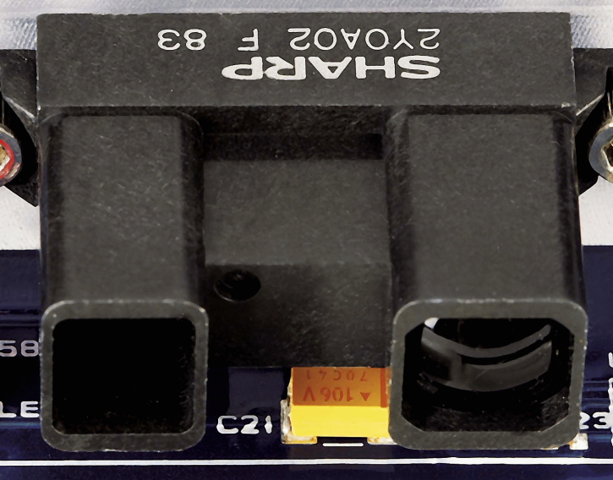
Infrared sensor on QNET sensors trainer

Slide 10
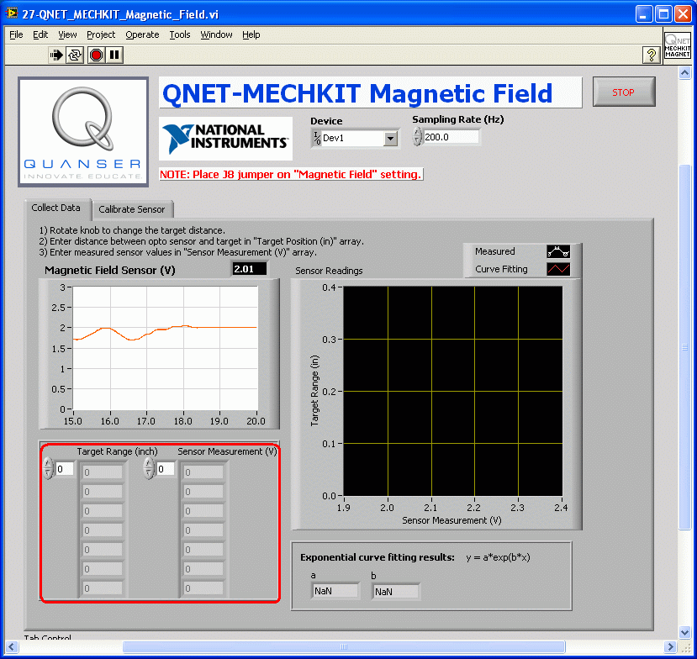
Magnetic field transducer on QNET sensors trainer

Slide 11
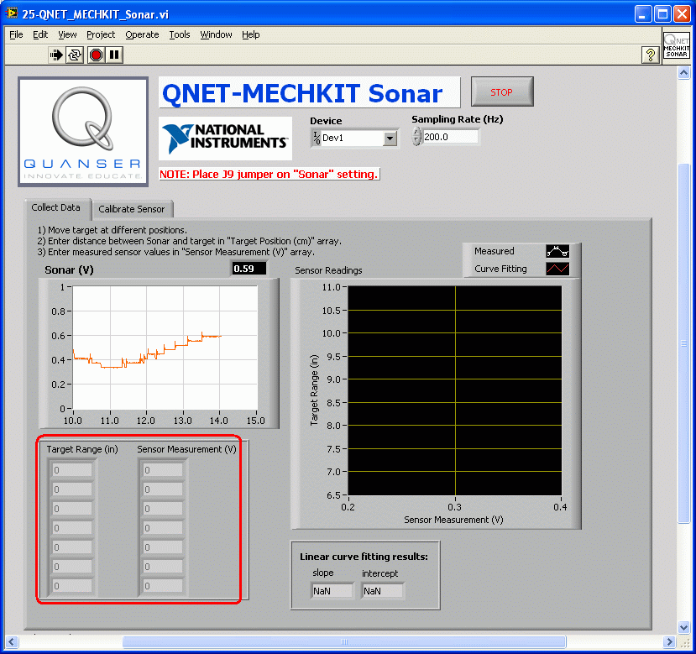
Sonar sensor on QNET sensors trainer

Slide 12
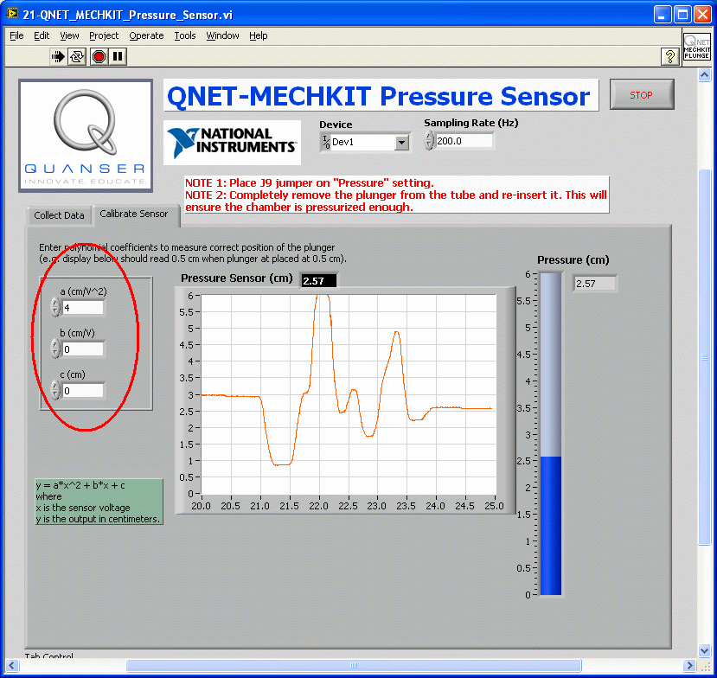
Pressure sensor on QNET sensors trainer

Slide 13
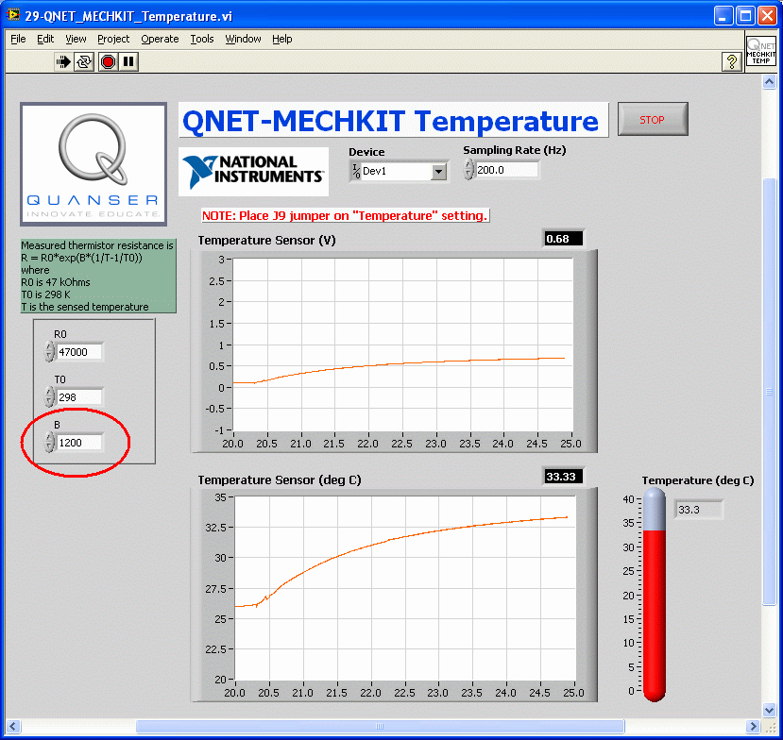
Temperature sensor on QNET sensors trainer

Slide 14
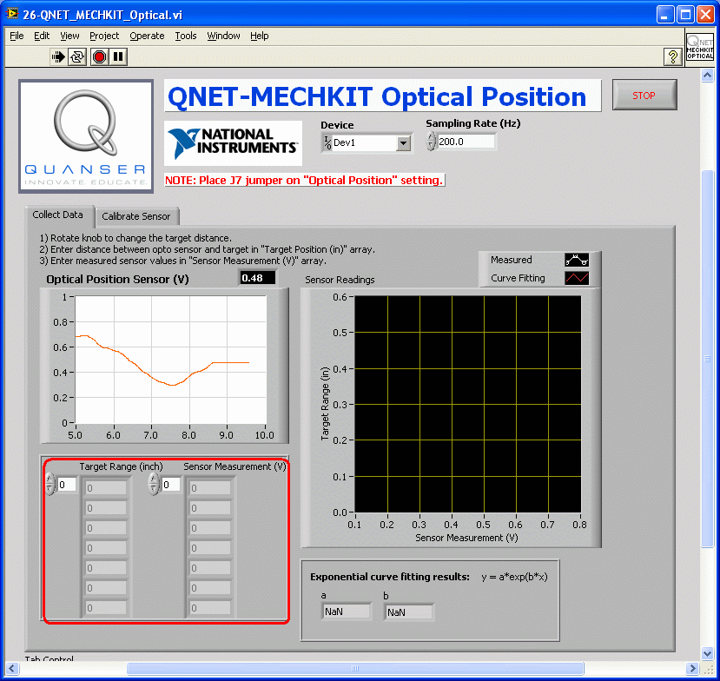
Optical position sensor on QNET sensors trainer

Slide 15
Quancer sensors
• Includes more than 10 different types of sensors:
Pressure sensor
Temperature sensor
Sonar, and infrared range sensors
Magnetic field sensor
Optical position sensor
Piezo film sensor
Rotary potentiometer
Micro switch, push button, and optical switch
Two digital output LEDs
Encoder
Strain gage

Slide 16
ELVIS II apparatus with additional precise measuring devices

Slide 17
Learning Modules to Design
Environmental Sensors Learning Module
Sensors to integrate on the basis of NI ELVIS protoboard:
1. Quancer sensors (described above)
2. Gas sensors CO2, O2
3. Radiation sensors (ionizing radiation)
Advanced Materials Analysis learning module:
Scanning Electron Microscope (SEM)
Transmission Electron Microscope (TEM)
Mass spectrometer
X-ray structural analysis (we have modern device in Iliauni)

Slide 18
Iliauni master programs which can use designed Learning Modules
MEW MATERIALS FOR NANOELECTRONICS AND NANOENGINEERING
EARTH SCIENCES: GEOLOGY, GEOPHYSICS, GEOGRAPHY AND GIS TECHNOLOGIES
ENERGY AND MINERAL RESOURCES MANAGEMENT AND SUSTAINABLE DEVELOPMENT

Slide 19
Accreditation Standards for Higher Education Programmes
Educational programme objectives, learning outcomes and their compliance with the programme
Teaching methodology and organization, adequate evaluation of programme mastering
Student achievements and individual work with them
Providing teaching resources
Teaching quality enhancement opportunities
Experience
Participated in commissions of 5 HEI programme Accreditation visits and
2 University Authorization visits

Slide 20
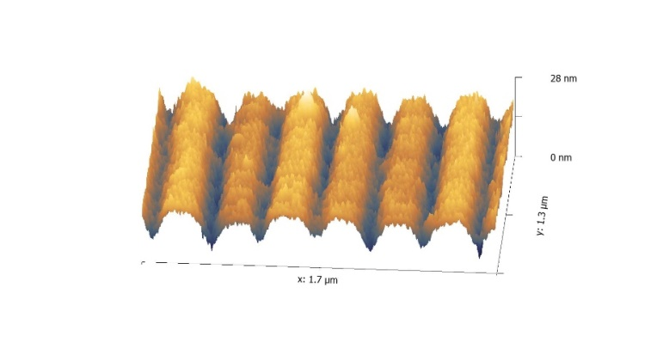
Research in nanotechnology and material science
Tavkhelidze, L. Jangidze, M. Mebonia, K. Piotrowski, J. Więckowski, Z. Taliashvili,
G. Skhiladze and L. Nadaraia, Physica Staus Solidi A, 214 (7), 1700334 (2017).
D. Kakulia , A. Tavkhelidze, V. Gogoberidze, M. Mebonia, Physica E 78,
pp. 49-55 (2016).
A. Tavkhelidze, Physica E, v. 60, pp. 4-10 (2014).
A. N. Tavkhelidze, J. Appl. Phys 108, 044313 (2010). A. Tavkhelidze, Nanotechnology, 20, 405401 (2009).

Slide 21
Thank you!

